Slide 1
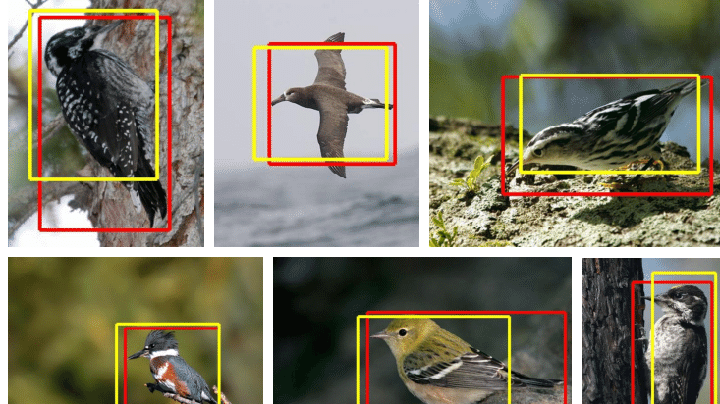
Object Localization
Anshu Pandey

Slide 2
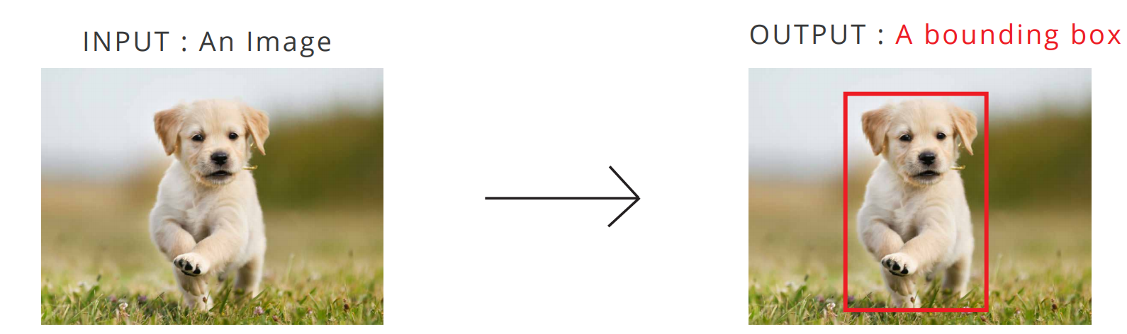
WHAT IS OBJECT LOCALIZATION?
Object localization predicts the object in an image as well as its boundaries.
Performed by drawing a bounding box around the location of the object in image.

Slide 3
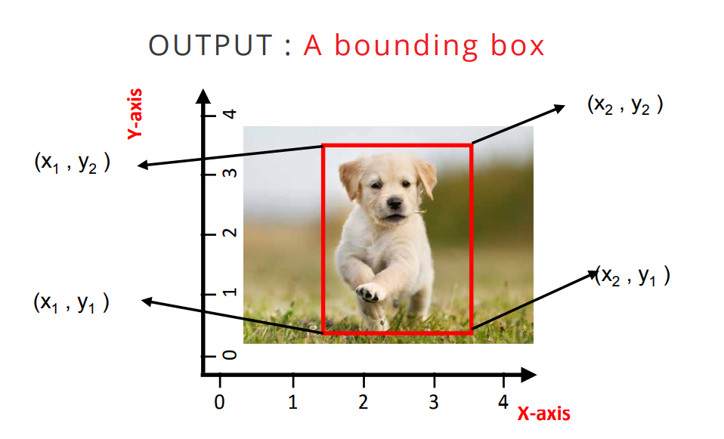
HOW TO FIND BOUNDING BOX FOR OBJECT LOCALIZATION?
Object bounding boxes are found using x-axis and y-axis coordinates based on the size of the image
Bounding box helps to separate most prominent object from background

Slide 4
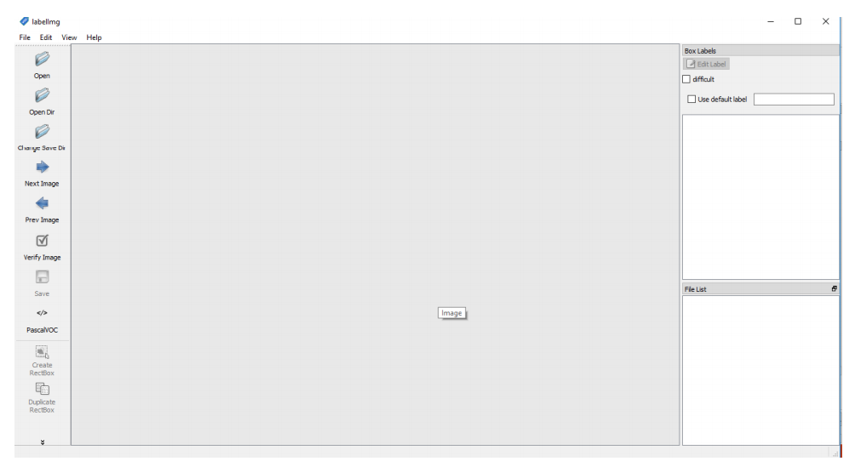
PREPERATION OF DATA WITH BOUNDING BOXS USING TOOL LABELIMG
Go to github link https://github.com/tzutalin/labelImg and download the tool
Run labelimg.py to open a GUI window as shown:

Slide 5
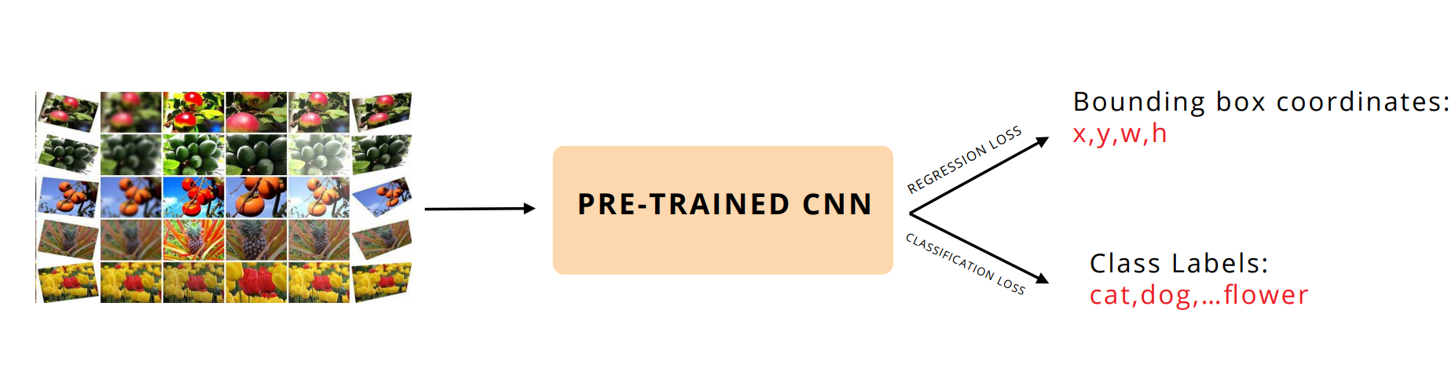
Object Localization

Slide 6
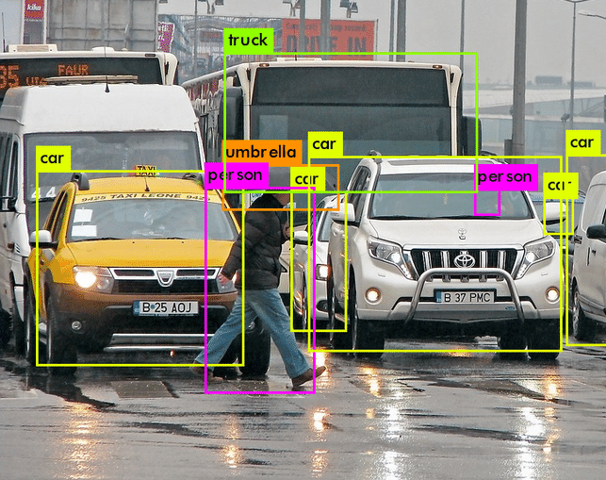
Object Detection

Slide 7
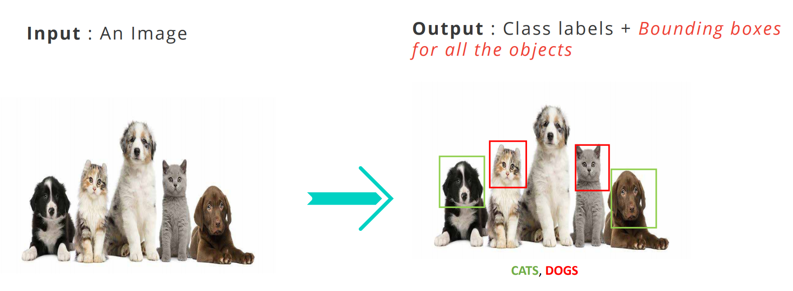
WHAT IS OBJECT DETECTION?

Slide 8
MEAN AVERAGE PRECISION (mAP)
The evaluation metric used in object recognition tasks is ‘mAP’. It is a number from 0 to 100 and higher values are typically better.
Each bounding box will have a score associated (likelihood of the box containing an object).
Based on the predictions, a precision-recall curve (PR curve) is computed for each class by varying the score threshold.
The average precision (AP) is the area under the PR curve. First the AP is computed for each class, and then averaged over the different classes. The end result is the mAP.

Slide 9
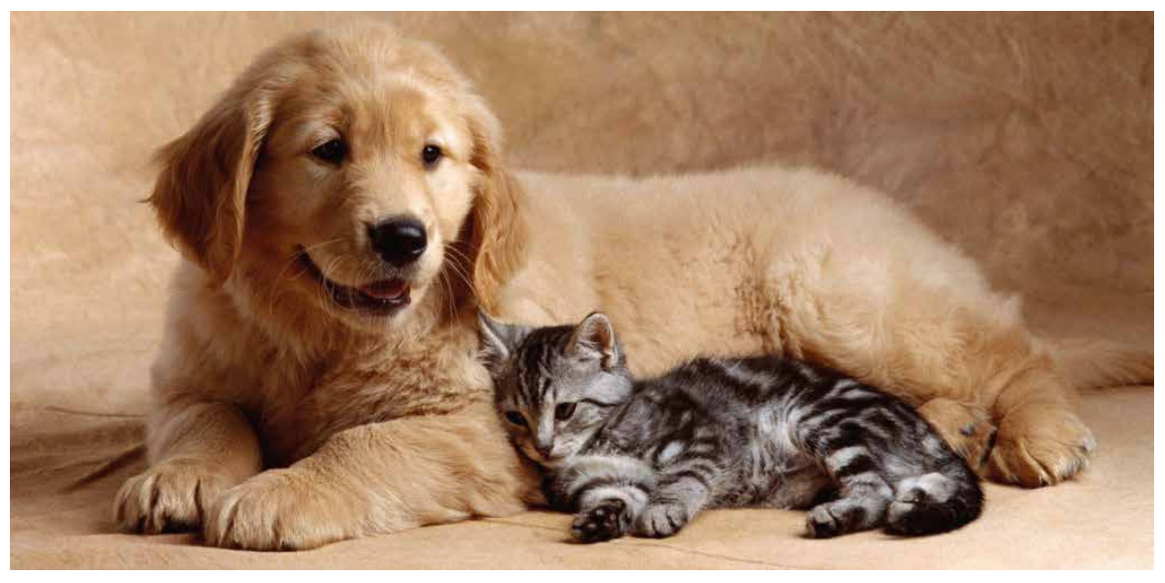
NAIVE WAY - SLIDING WINDOW FOR OBJECT CLASSIFICATION
1. First, we take an image as input:

Slide 10
NAIVE WAY - SLIDING WINDOW FOR OBJECT CLASSIFICATION
2. We decide a window size and slide it across an image to obtain corresponding regions.

Slide 11
NAIVE WAY - SLIDING WINDOW FOR OBJECT CLASSIFICATION
3. Pass all these regions (images) to the CNN and classify them into various classes.
4. Once we have divided each region into its corresponding class, we can combine all these regions to get the original image with the detected objects

Slide 12
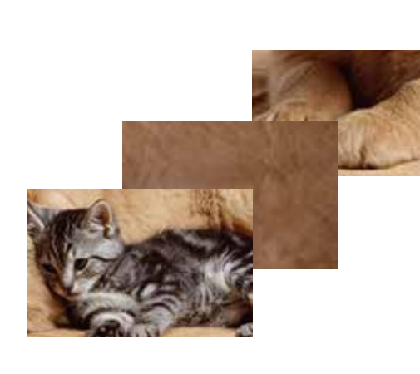
PROBLEM WITH COMPUTATIONAL COMPLEXITY
A huge number of regions are obtained as the image gets larger.
Results in large amount of computational time.

Slide 13
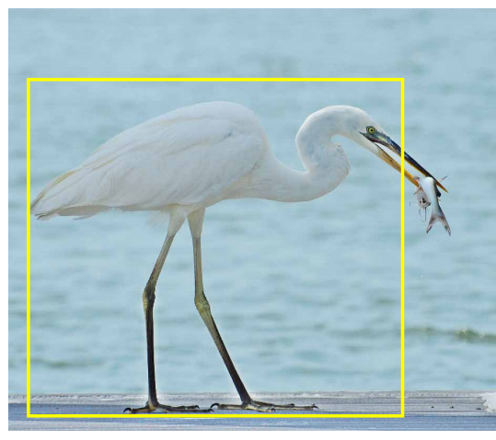
PROBLEM WITH SCALE: WHAT SHOULD BE THE WINDOW SIZE
A fixed window size cannot capture all objects in an image.
Objects in an image have different scales.
The bird is detected but the fish is not due to its smaller size.
All sizes of objects must be captured by the object detector.

Slide 14
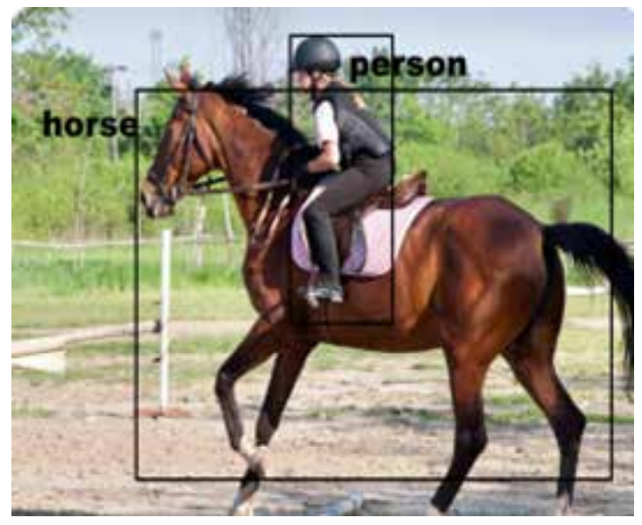
PROBLEM WITH SCALE: WHAT SHOULD BE THE WINDOW SIZE
Objects in an image can have different aspect ratios and spatial locations.
Here the person is tall and thin whereas the horse is broad.

Slide 15
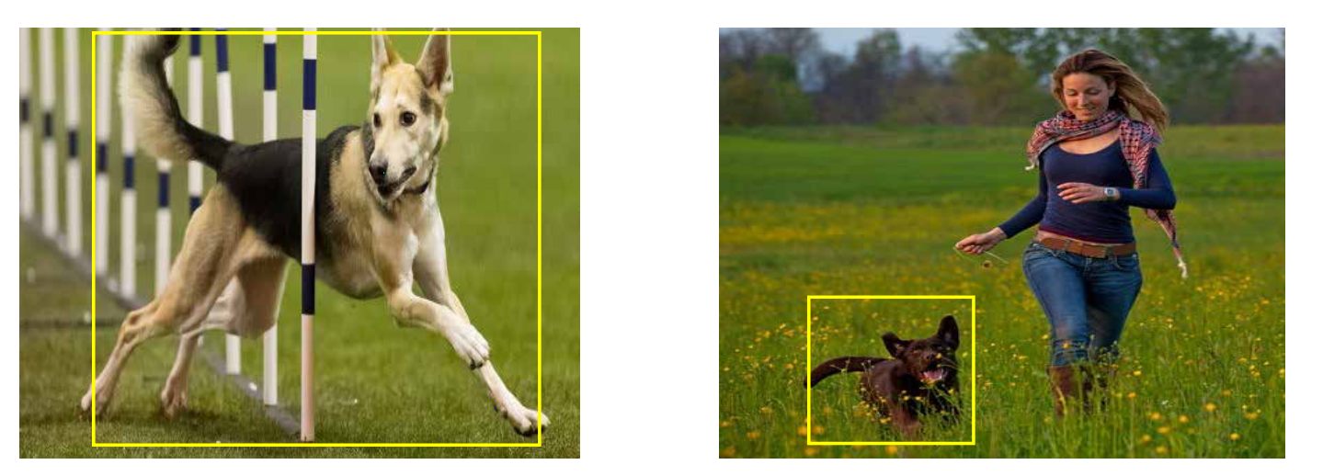
PROBLEM WITH OBJECT COVERAGE IN IMAGE
Some cases the object might be covering most of the image
While in others , the object might only be covering a small percentage of the image.

Slide 16

SOLUTION - RCNN

Slide 17
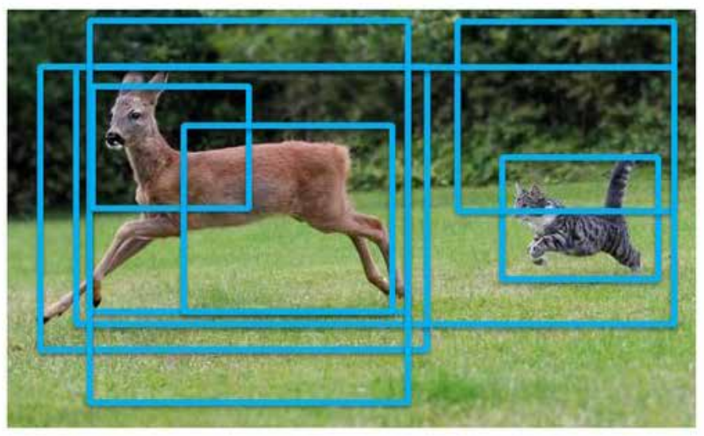
What is RCNN?
Region based CNN or RCNN proposes a set of regions as bounding boxes and sees if any of them actually correspond to an object.

Slide 18
WHO PROPOSED R-CNN
Inspired by the research of Hinton’s lab at the University of Toronto, a small team at UC Berkeley, led by
Professor Jitendra Malik, comprised of
Ross Girshick,
Jeff Donahue, and
Trevor Darrel
proposed R-CNN by testing on the PASCAL VOC challenge.

Slide 19
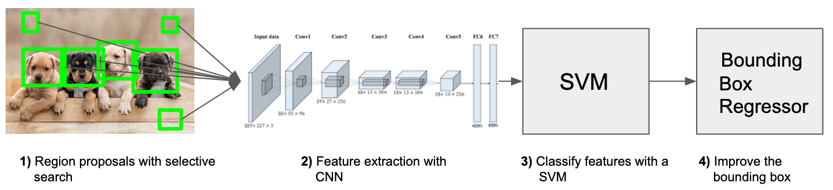
RCNN

Slide 20
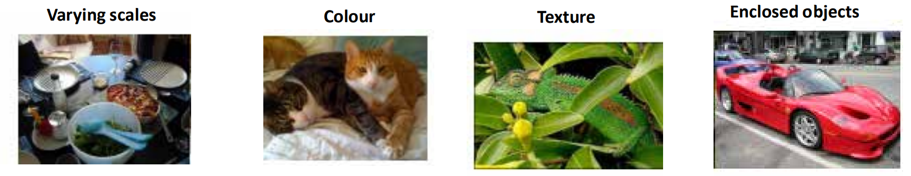
WHAT IS SELECTIVE SEARCH AND HOW IT IDENTIFIES DIFFERENT REGIONS?
Selective search identifies patterns in the image and combines similar patterns based on the following characteristics, to propose various regions:

Slide 21
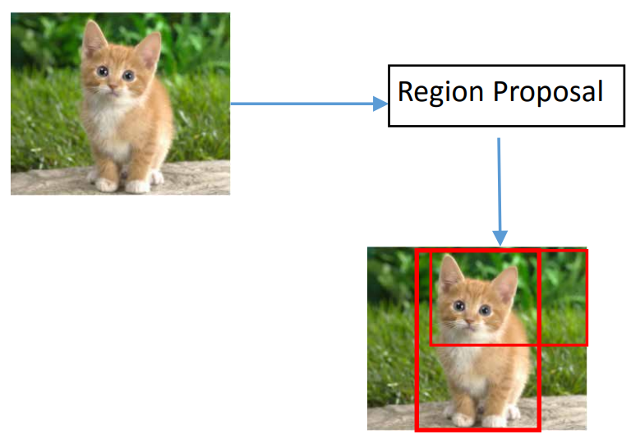
HOW DO WE FIND WHERE THESE BOUNDING BOXES ARE?
Solution: Region Proposal Method
RCNN uses selective search to extract boxes from an image.
It tries to find boxes of different sizes where it feels there might be an object.
RCNN algorithm proposes a bunch of 2000 boxes called regions in an image.

Slide 22
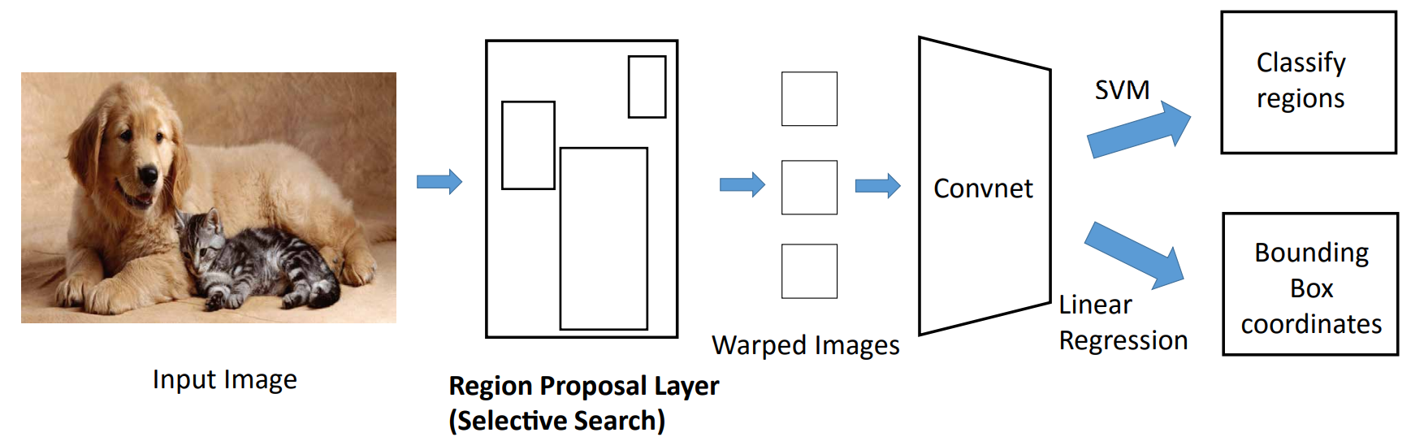
ARCHITECTURE OF R-CNN

Slide 23
HOW DOES R-CNN WORK?
1. An image is input to the network.
2. Generates 2000 regions of interest using Selective search.
3. Convert regions into fixed sized images
4. Each region proposal is passed into a CNN for feature extraction
5. Linear SVM classifier helps classify objects
6. Regression model finds bounding box coordinates

Slide 24
LIMITATIONS OF R-CNN
Training an RCNN model is expensive and slow
Takes a huge amount of time to train the network as there are 2000 region proposals per image.
Cannot be implemented real time as it takes around 47 seconds for each test image.

Slide 25
FAST RCNN
Fast RCNN inputs an image and a group of region proposals. The convolutional network is trained on the whole image instead of individual regions.
Hence the computation time is reduced from 2000 convolutions to 1 convolution

Slide 26
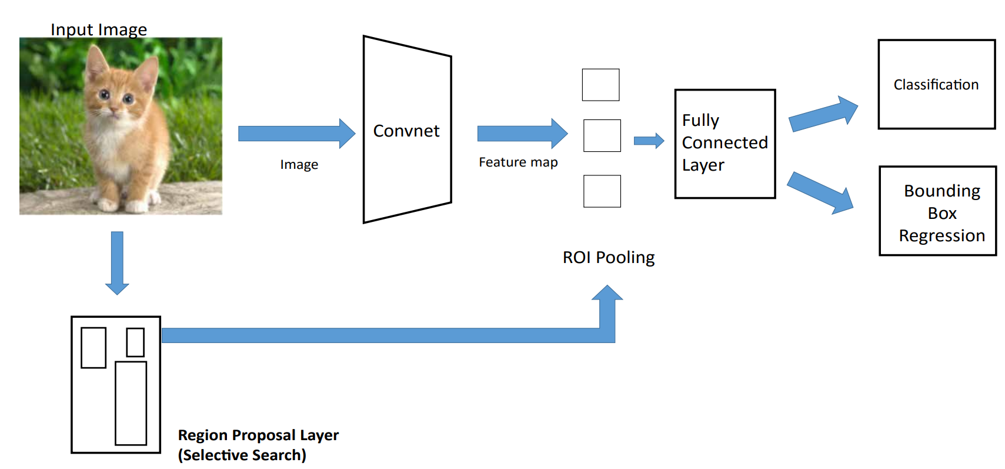
FAST RCNN

Slide 27
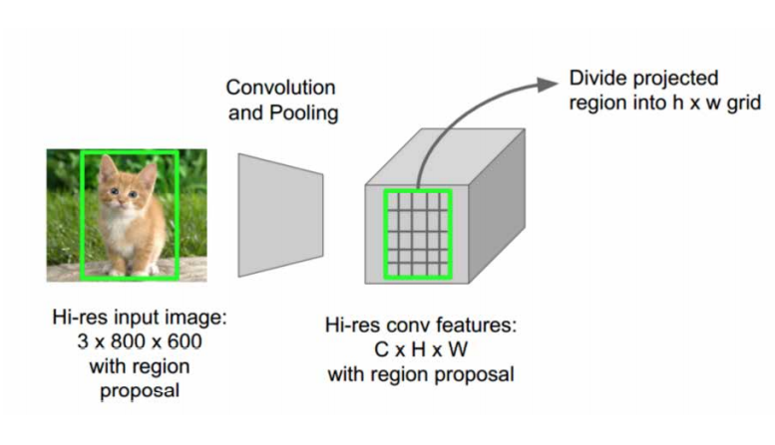
USE OF CONVOLUTIONAL LAYERS
CNNs extract high level features from image like lines, edges, shapes.
The Fast R-CNN detector processes the entire image. Hence we did the work of 2000 convolutions in a single step.
Fast R-CNN chooses CNN features corresponding to each region proposal.

Slide 28
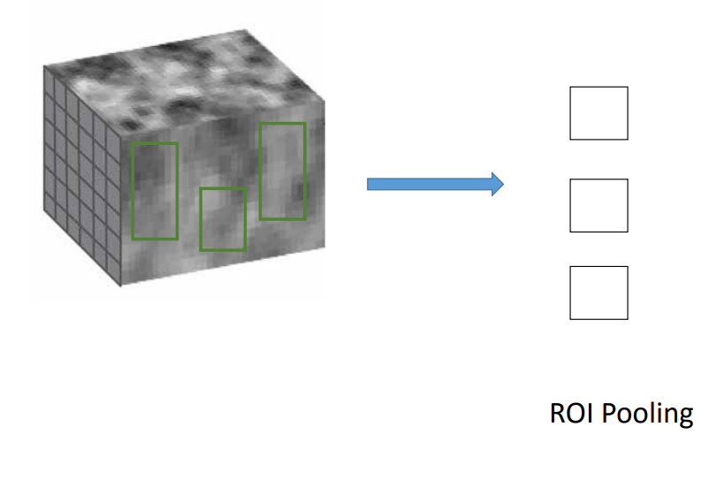
USE OF REGION PROPOSAL LAYER AND ROI POOL
ROI pool layer convert these regions to a smaller feature map of fixed size before feeding to fully connected neural network.
This is done using max pooling or average pooling.

Slide 29
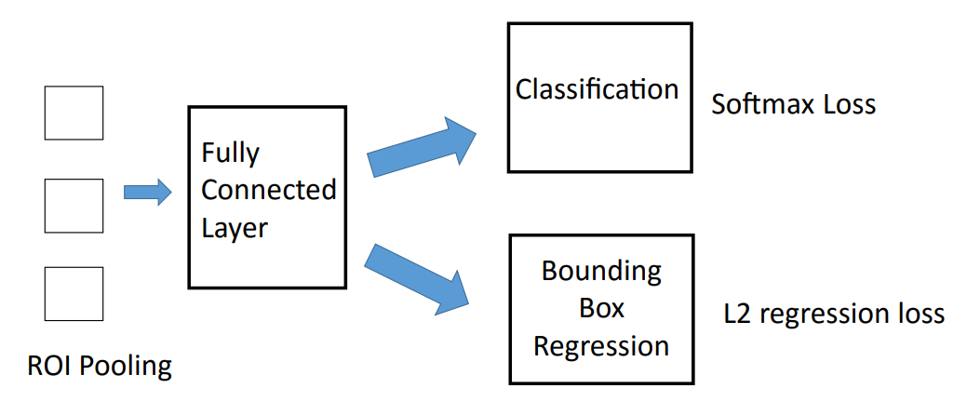
FULLY CONNECTED LAYER AND FINAL PREDICTION
Fully Connected layers are used to produce 2 outputs.
Predict the class label of the object in ROI
Regression to find (x, y, w, h) coordinates of Bounding Box
x, y = X and Y coordinates of the bounding box
w = width of bounding box
h = height of bounding box

Slide 30
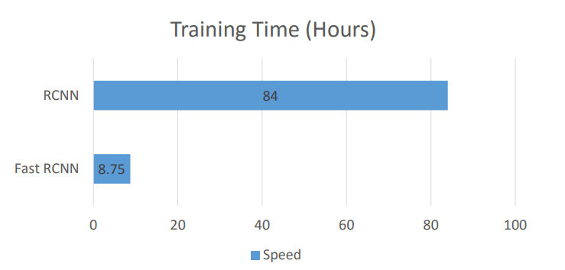
PERFORMANCE OF FAST RCNN IN TRAINING
Fast RCNN is10x faster compared to RCNN because
Only a single image is processed by a CNN, instead of 2000 CNNs on images obtained from selective search in RCNN algorithm.

Slide 31
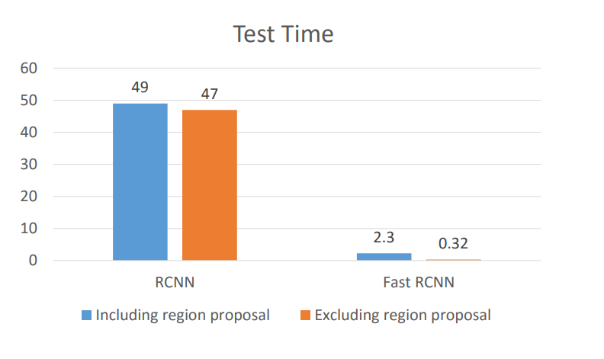
PERFORMANCE OF FAST RCNN IN TEST
Fast RCNN is really fast in prediction.
The only bottleneck is region proposal which takes almost 2 seconds which is a lot of time.

Slide 32
LIMITATIONS OF FAST RCNN
Region proposal takes a lot of time (2 seconds).
Selective Search is a slow and time consuming process which is unsuitable for real world, large datasets.
This issue is resolved with Faster RCNN.

Slide 33
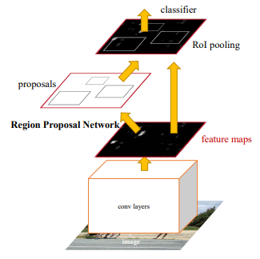
FASTER RCNN
Faster RCNN uses an inbuilt region proposal network (RPN) to generate region proposals directly in the network without using an external algorithm like Selective search.

Slide 34
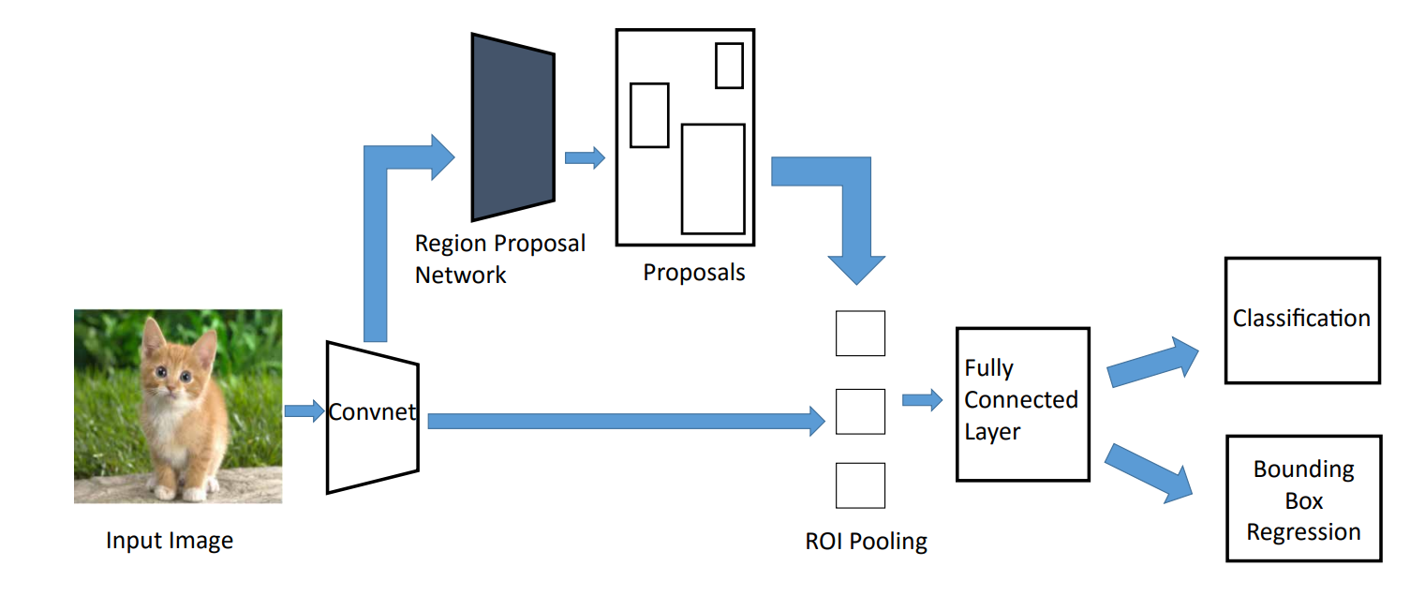
FASTER RCNN NETWORK

Slide 35
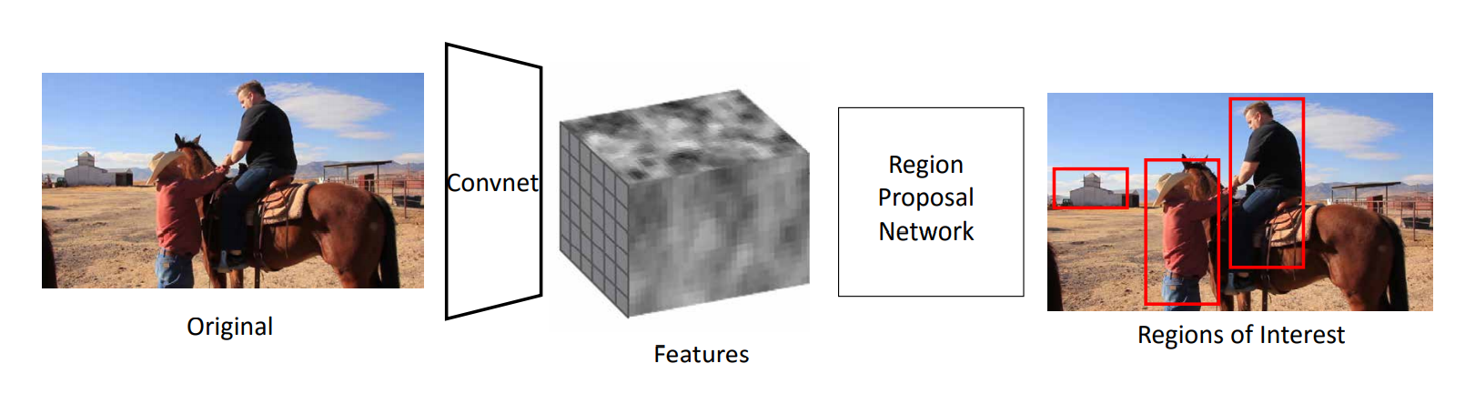
REGION PROPOSAL NETWORK
Region Proposal Network creates boxes called anchors which are most likely to contain object.

Slide 36
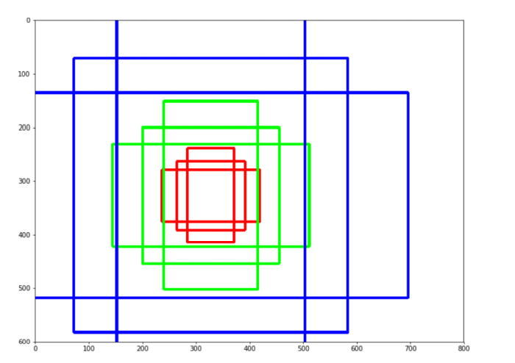
ANCHORS IN FASTER RCNN
Anchors are fixed boxes placed across the images to find location of object.
Faster RCNN has 9 anchors of fixed size like 128x128, 256x256 and 512x512 (red, green and blue).
For each size, the width to height ratio is 1:1, 1:2 and 2:1.

Slide 37
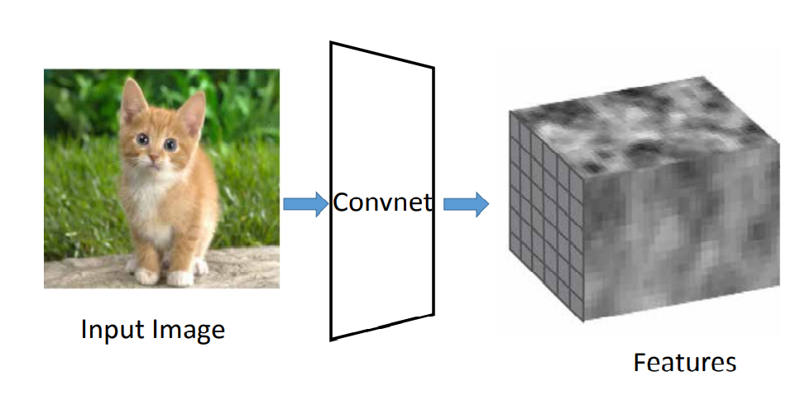
STEP1 : CONVOLUTIONAL LAYER
First a picture goes through convolutional layer and feature maps are extracted.

Slide 38
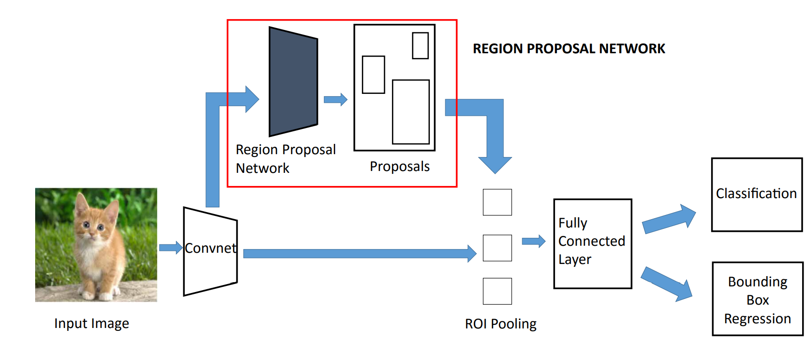
STEP2 : REGION PROPOSAL NETWORK

Slide 39
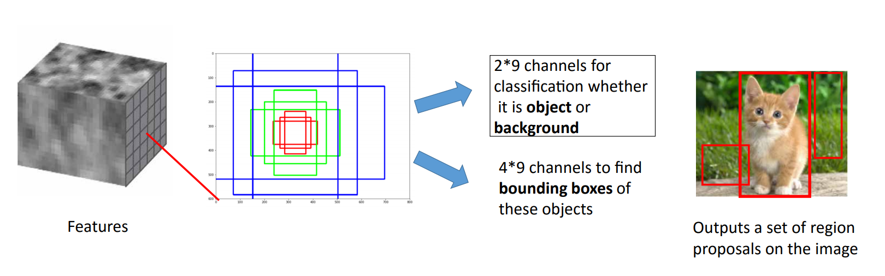
STEP2 : REGION PROPOSAL NETWORK
A sliding window is drawn over each point in feature map. At every point, 9 anchor boxes are drawn for generating region proposals

Slide 40
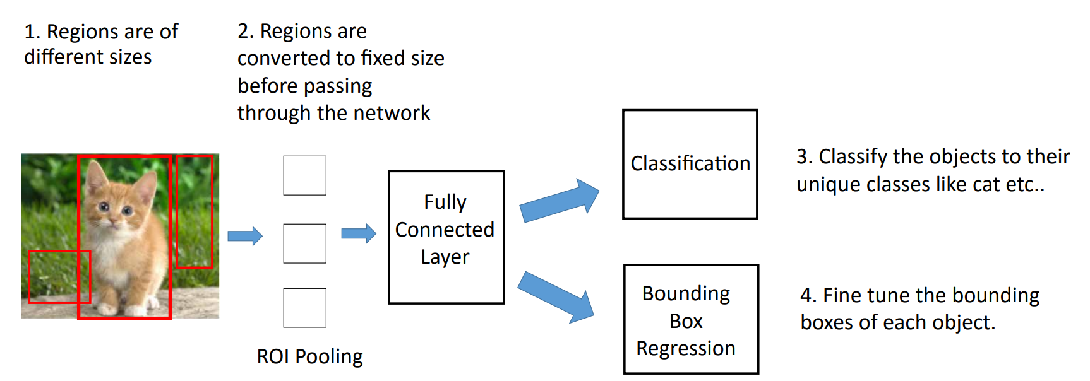
STEP3 : DETECTION NETWORK

Slide 41
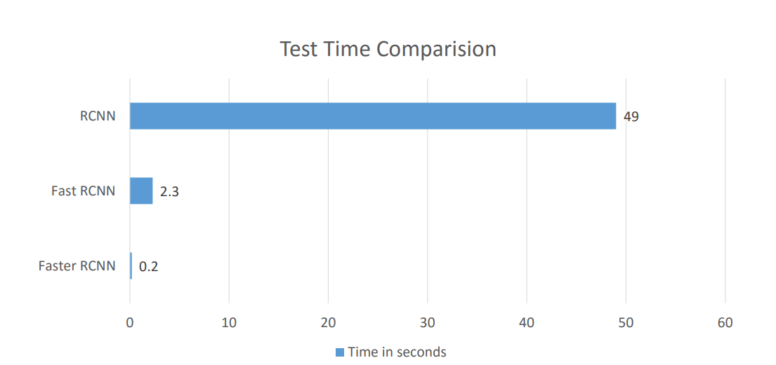
PERFORMANCE OF FASTER RCNN

Slide 42
SSD

Slide 43
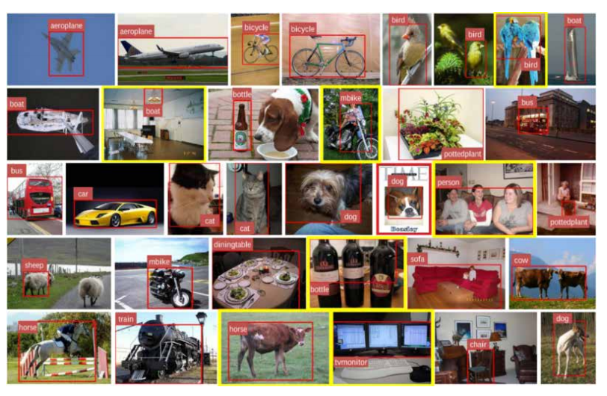
SSD - SINGLE SHOT MULTIBOX DETECTOR
SSD was released on November 2016.
It reached new records in terms of performance and precision for object detection tasks, scoring over 74% mAP (mean Average Precision) at 59 frames per second on standard datasets such as PascalVOC and COCO.

Slide 44
WHAT IS SSD?
Single Shot Multibox Detector is a method for detecting objects in images using a single deep neural network.

Slide 45
WHY SSD?
SSD are designed for object detection in real-time.
SSD speeds up the process by eliminating the need of the region proposal network.
To recover the drop in accuracy, SSD applies a few improvements including multi-scale features and default boxes.

Slide 46
ARCHITECTURE OF SSD
Single Shot: Tasks of object localization and classification are done in a single forward pass of the network
MultiBox: name of a technique for bounding box regression
Detector: The network is an object detector that also classifies those detected objects

Slide 47
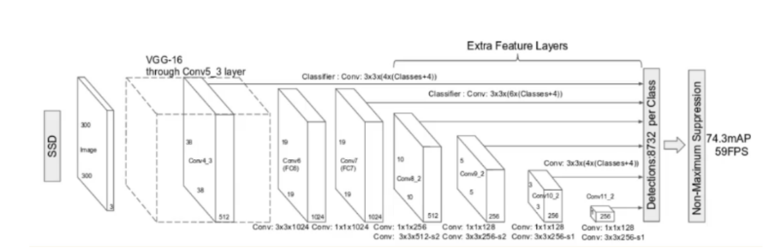
ARCHITECTURE OF SSD

